Slide 1
Swift Language
Value Returning functions

Slide 2
Value returning function
Programs can become hard for humans to read and understand
Decomposing a program into functions can greatly aid program readability, helping yield an initially correct program, and easing future maintenance
A function may return one value using a return statement
To let a function return a value, use the return statement
In Python, you can return multiple values by simply return them separated by commas

Slide 3
Value returning function
Input
Function
Input
Input
Input
Function
Output
Output
Output
Function
Output
Output

Slide 4
Return value function definition
func function-name(input parameter(s))->(output type(s)
{
statement 1
statement 2
statement n
return output-parameter
}

Slide 5
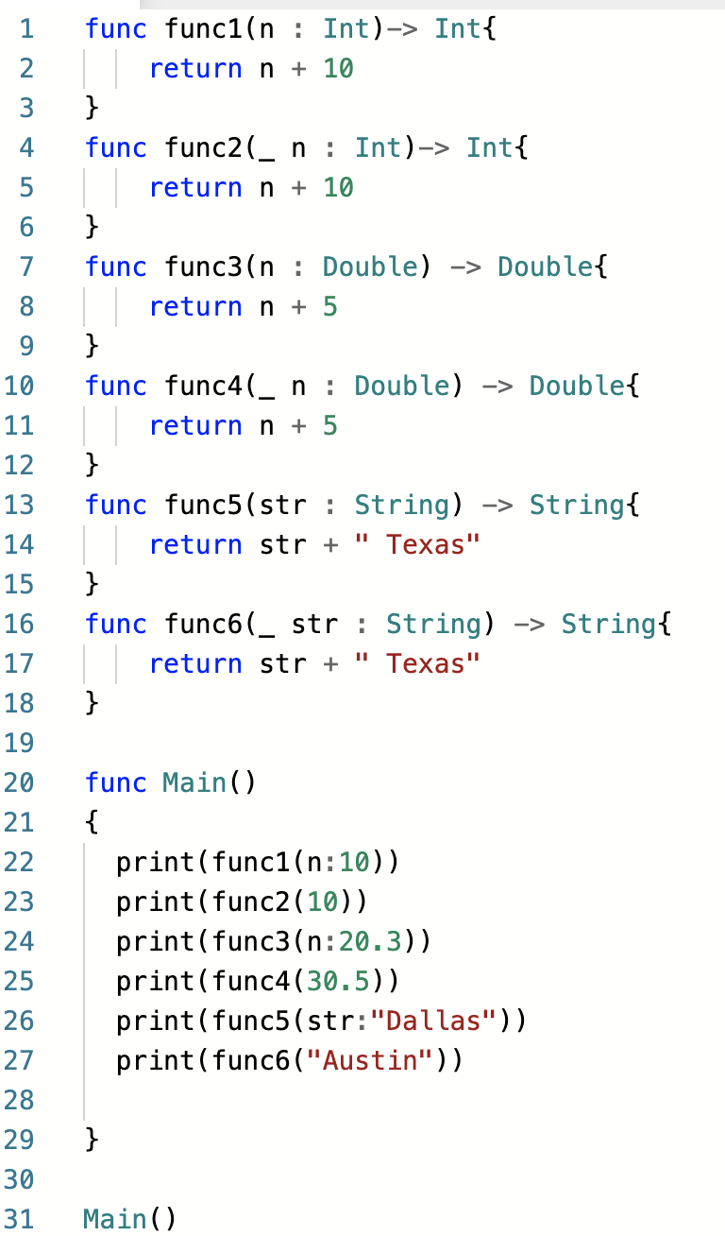
Value returning function definition and call

Slide 6
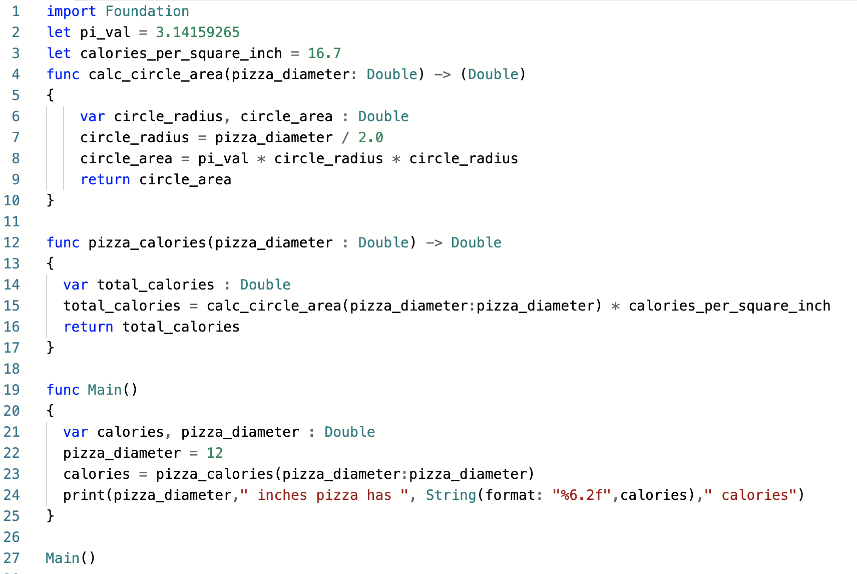
Value returning function definition and call

Slide 7
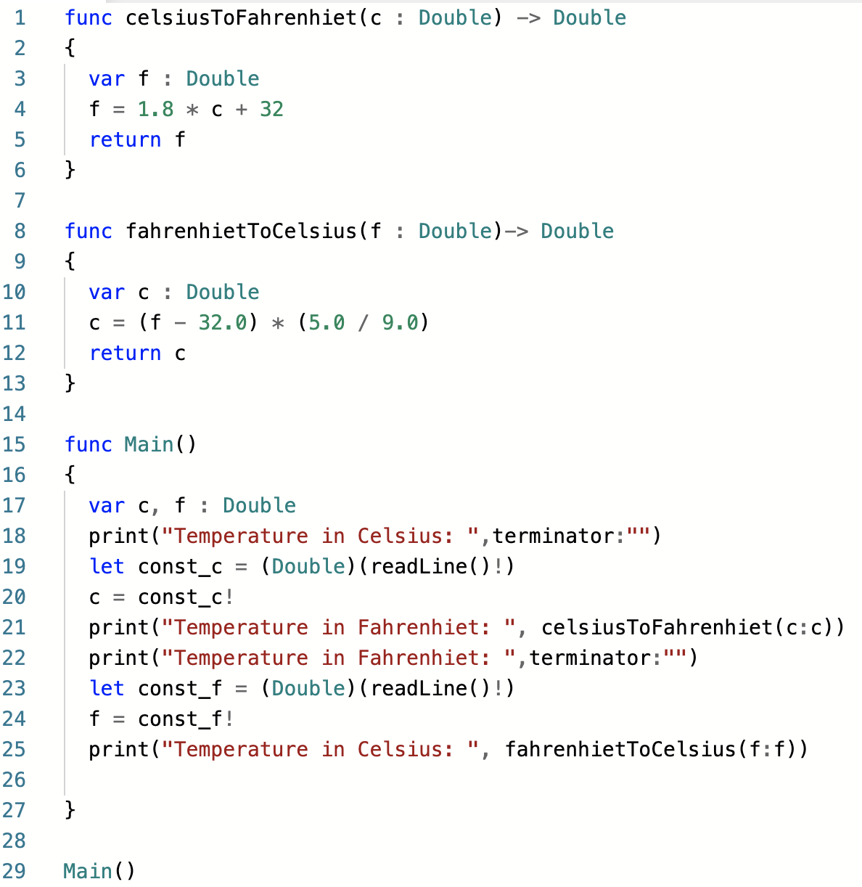
Value returning function definition and call

Slide 8
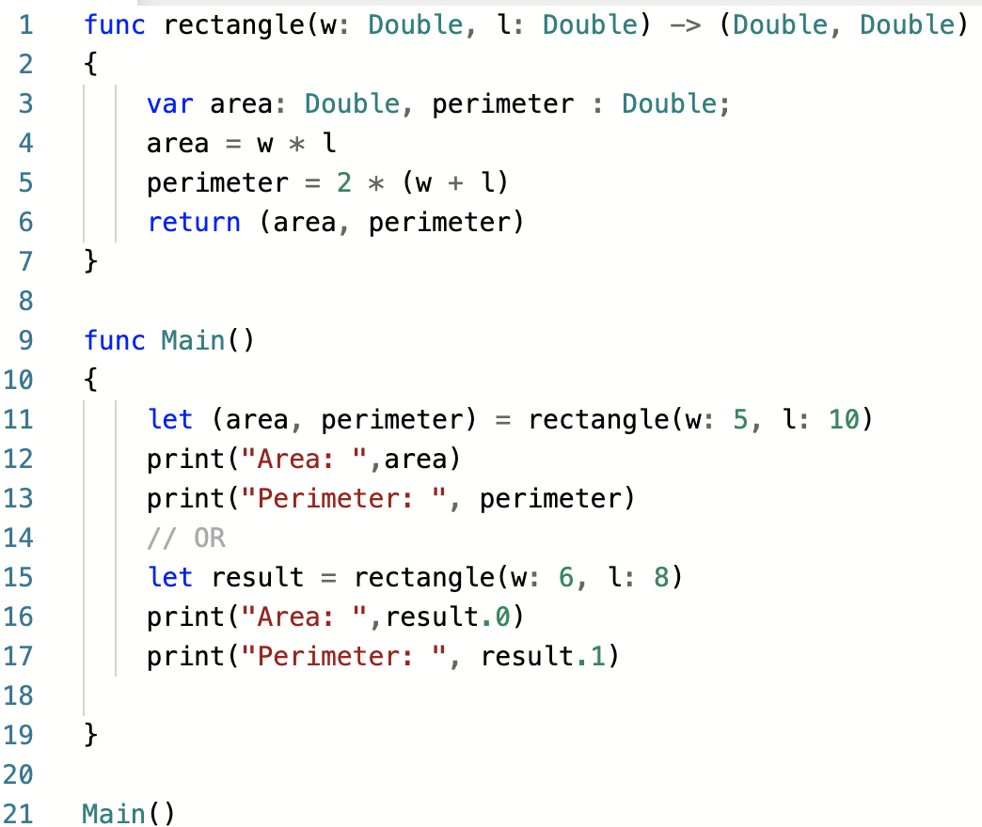
Value returning function definition and call

Slide 9
Global Variables and Global Constants
Global variable: created by assignment statement written outside all the functions
Can be accessed by any statement in the program file, including from within a function
If a function needs to assign a value to the global variable, the global variable must be redeclared within the function
General format: global variable_name

Slide 10
Global Variables and Global Constants
Reasons to avoid using global variables:
Global variables making debugging difficult
Many locations in the code could be causing a wrong variable value
Functions that use global variables are usually dependent on those variables
Makes function hard to transfer to another program
Global variables make a program hard to understand

Slide 11
Global Constants
Global constant: global name that references a value that cannot be changed
Permissible to use global constants in a program
To simulate global constant in Python, create global variable and do not re-declare it within functions

Slide 12
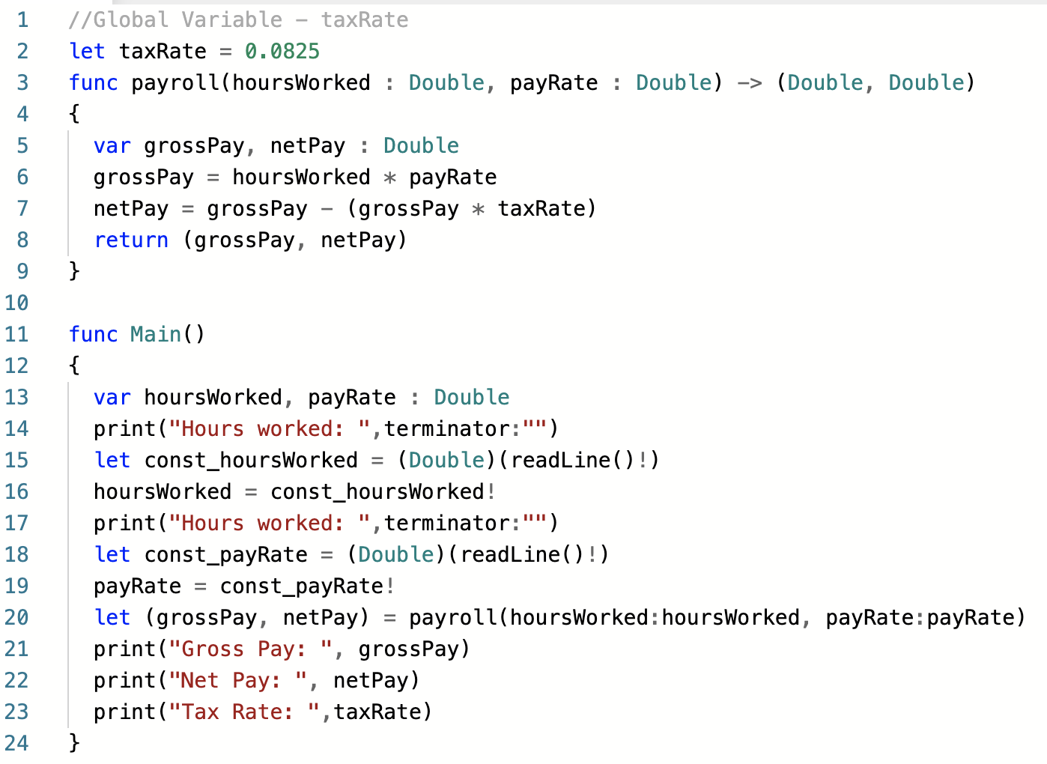
Global variables
global variable

Slide 13
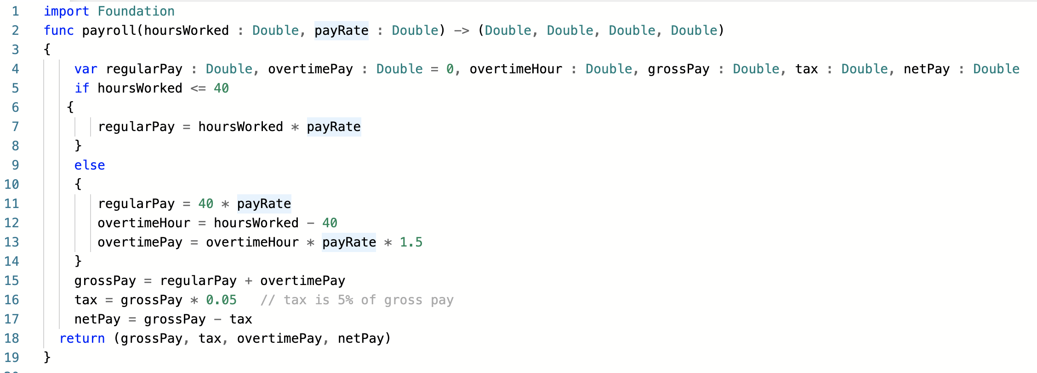
Value returning function definition and call

Slide 14
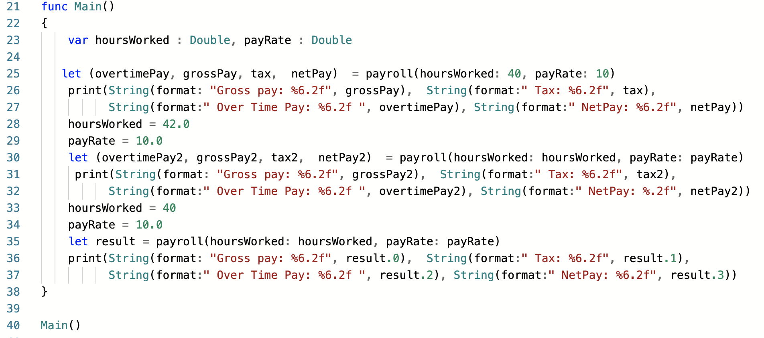
Value returning function definition and call

Slide 15
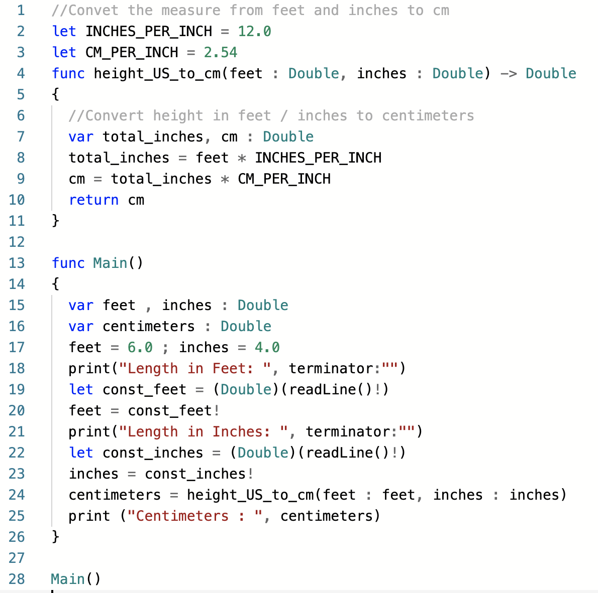
Value returning function definition and call

Slide 16
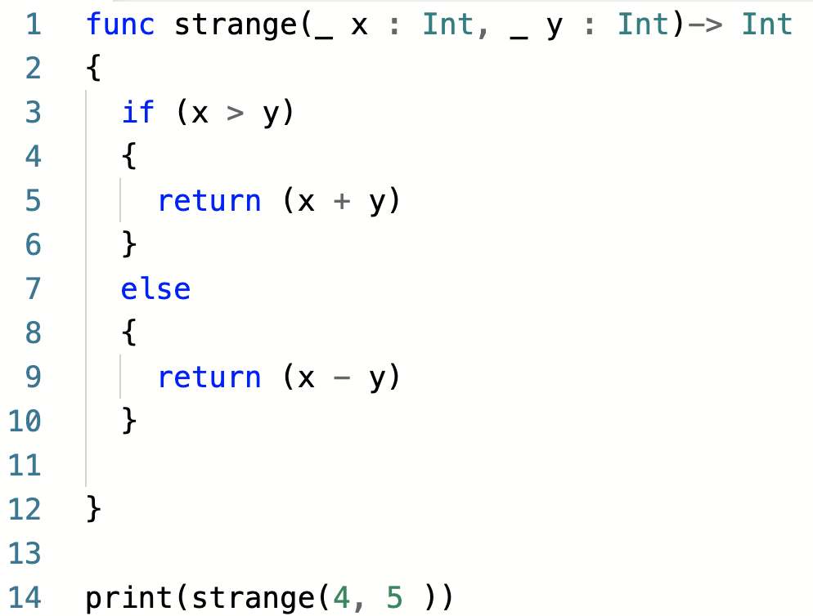
Value returning function definition and call

